Slide 1
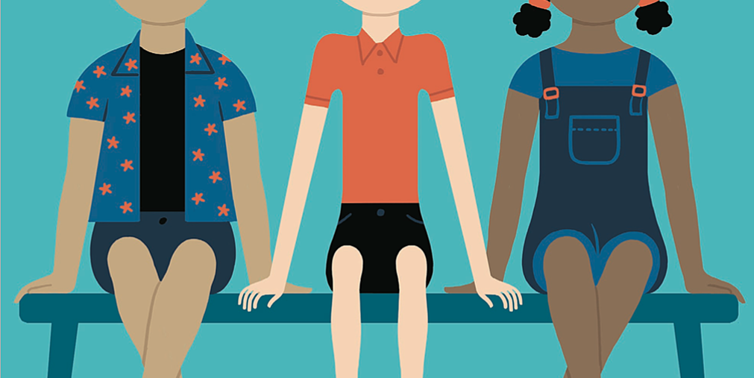
When is in-group social learning selectively advantageous?
-Daniel Saunders, University of British Columbia

Slide 2
Individuals have to figure out what the right norm is for getting along in their social groups, keeping in mind that different social groups culturally evolve different norms. By ‘‘right,’’ we mean the norm that allows the individual to maintain their reputation, avoid punishment for norm violations, and coordinate their behavior with other members of their social group. …
Human psychology evolved to seek out ‘‘indicator traits’’ (language, dress, etc.) that match its own because people who have the same markers tend to also have the ‘‘right’’ norms. Using such markers, individuals can bias both their learning from, and interaction with, those individuals who share their same culturally transmitted indicator traits.
- Natalie Henrich and Joseph Henrich, 2007

Slide 3
Experiments on learning biases
Gender-biased social learning
Race- or Ethnicity-biased social learning
Perry and Bussey 1979 – Supportive results
Bussey and Bandura 1984 – Supportive results
Shutts, Banaji, and Spelke 2010 – Supportive results
Losin et al. 2012 – Supportive results
Frasier et al. 2012 – Supportive results
Kinzler, Dupoux, and Spelke 2007 – Supportive results
Shutts et al. 2009 – Supportive results
Shutts, Banaji, and Spelke 2010 – Null results
Kinzler, Corriveau, and Harris 2011 – Supportive results
Buttelmann et al. 2013 – Mixed results
Howard et al. 2015 – Null results
Krieger et al. 2016 – Null results

Slide 4
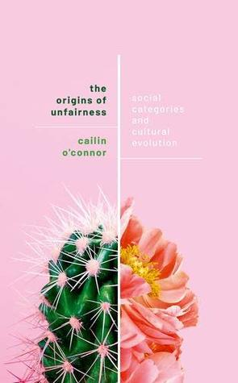
Gender and the division of labor
 | Player 2
Player 1 |  | A | B
 | A | 0, 0 | 1, 1
 | B | 1, 1 | 0, 0

Slide 5
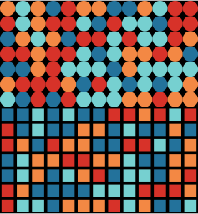
Initial conditions
Two identifiable groups – representing males and females. They are depicted by circles and squares.
Random initial behavioral strategies – players can:
Play A against everyone
Play B against everyone
Play A against males and B against females
Play B against males and A against females.
Random initial learning strategy:
Learn from anyone
Learn from people with your sex

Slide 6
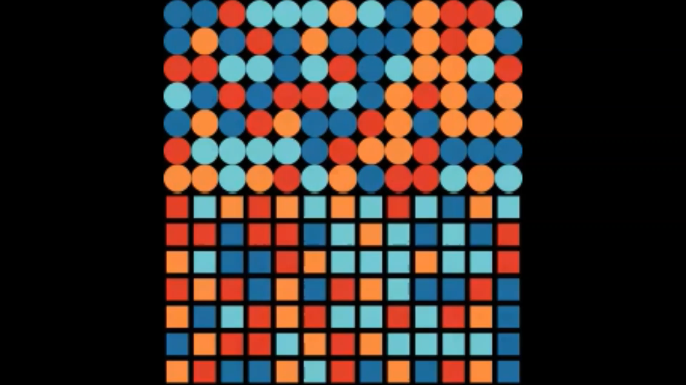
Dynamics
Play – pick a random partner. Play the coordination game.
Learn behavior – If you have the learning-bias, pick a partner that shares your sex. Otherwise, pick a random partner. If their payoff is larger, copy their behavioral strategy.
Learn learning strategy – Pick a random partner. If their payoff is larger, copy their learning strategy.

Slide 7
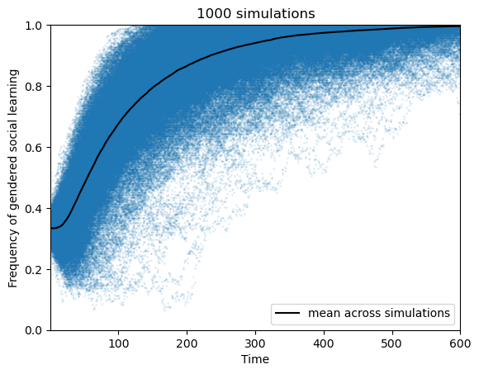
Results

Slide 8

Ethnicity and coordination problems
 | Player 2
Player 1 |  | A | B
 | A | 1, 1 | 0, 0
 | B | 0, 0 | 1, 1

Slide 9
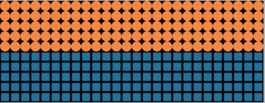
Initial conditions
Two identifiable groups. The identifiers represent ethnic markers, depicted by circles and squares. The groups begin with distinct coordination behaviors.
A fixed preference for interacting with people who share ethnic markers. This is a parameter that controls the probability of pairing up with people from your group.
Fixed proportion use ethnicity-biased social learning. A certain number of players only learn from people who share their ethnic markers.

Slide 10
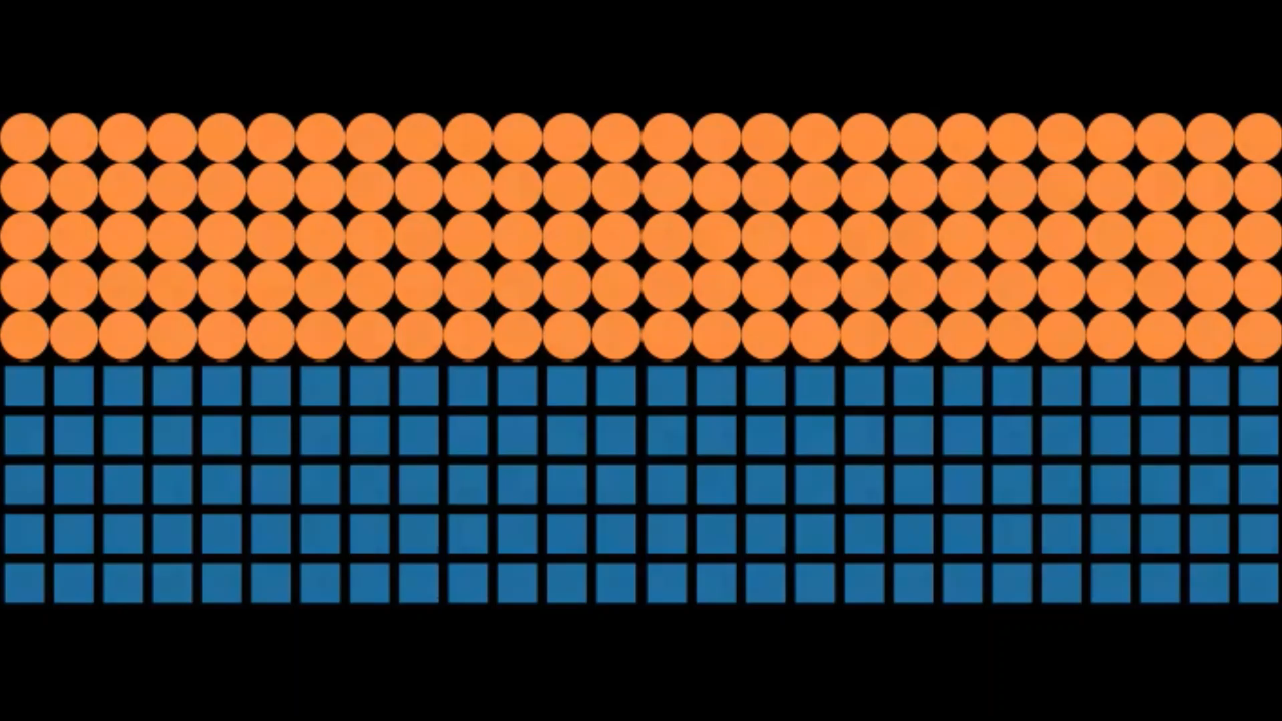
Dynamics
Play – Pick a partner. With some probability, it is a random partner. Otherwise, it is someone who shares your ethnic marker. Play the coordination game.
Learn behavior – Pick a partner. If your have the ethnicity bias, your partner shares your ethnic marker. Otherwise, it is a random partner. If they received a larger payoff than you, copy their behavioral strategy.
Learn learning strategy – Pick a random partner. If they received a larger payoff than you, copy their learning strategy.

Slide 11
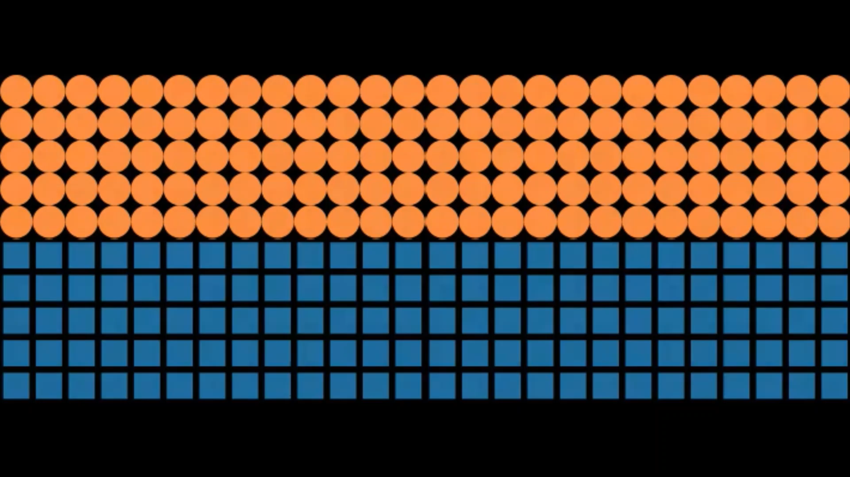
Fragility

Slide 12
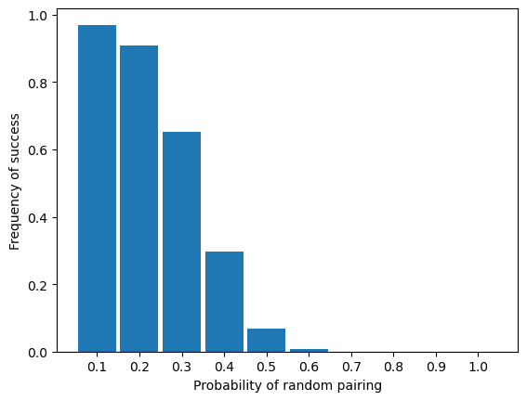
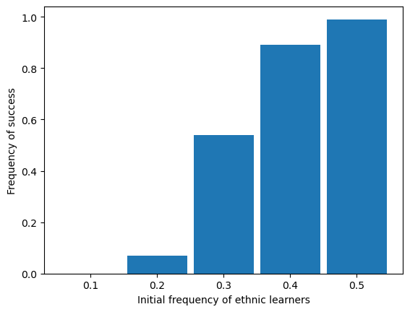
Parameter Sensitivity

Slide 13
Conclusions
1. Parallel between evolutionary theoretical results and experimental results:
Gender-biased learning is highly robust in models and experiments.
Ethnicity-biased learning is fragile in models and experiments.
2. Asymmetry between explanations of gender and racial inequality. Bargaining models are plausible candidates for explaining the origins of inequality. Less clear with race or ethnicity.
3. Papers applying two-population bargaining models to race should be more explicit about what justifies the two-population structure. Other possible justification:
Structural constraints on learning, like spatial or network effects
Better evolutionary stories

